Slide 1

Gestion of an sport event
Name: diego de Luis ballesteros

Slide 2
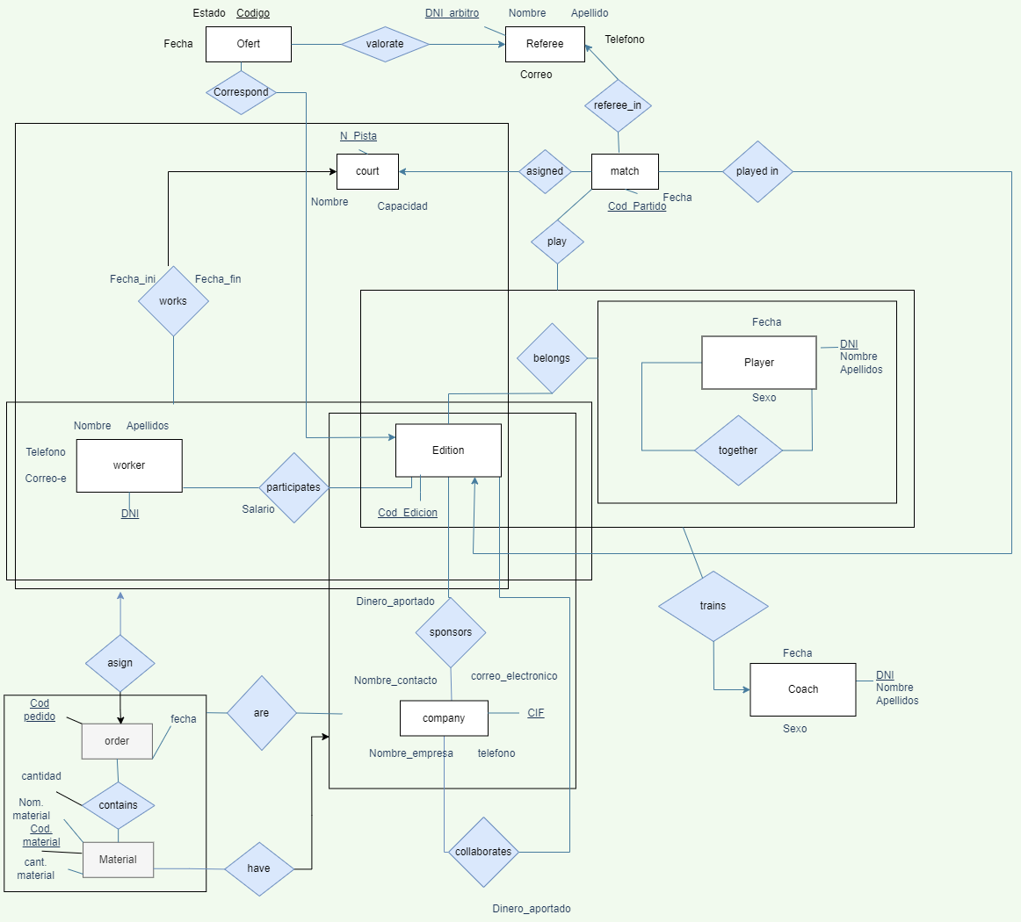
Main E/R
I took this diagram from my university in Spain, and I translated the name of the tables to english

Slide 3


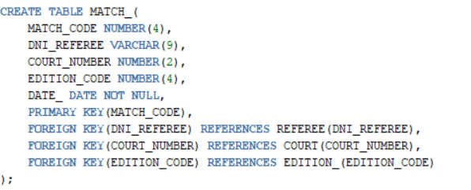

Previous data
Table referee_in inside the match_ table (we can see in dni_referee value)

Slide 4
Database Access and main interface
Oracle local database in computer

Slide 5
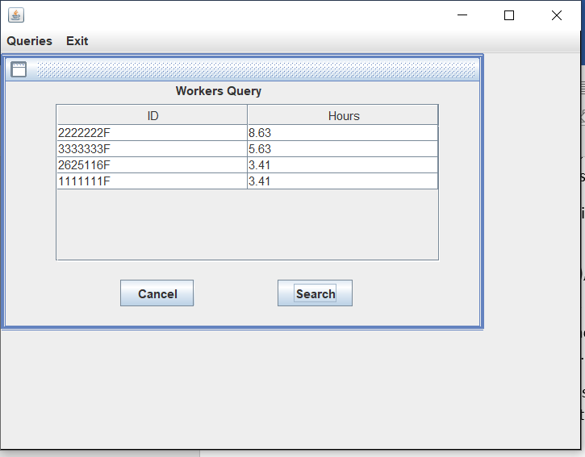
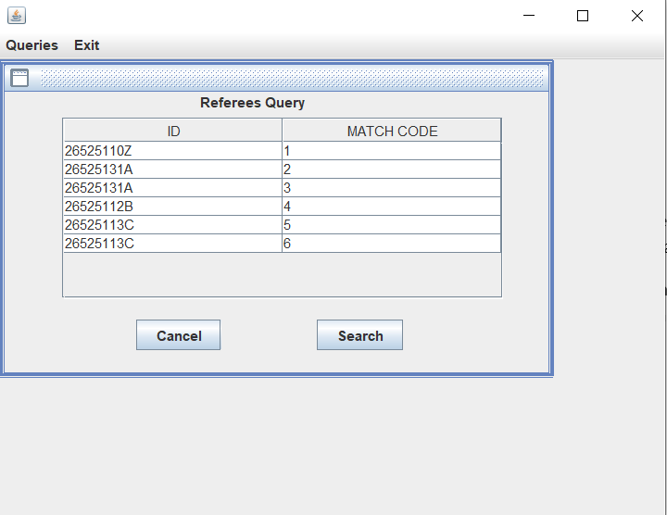
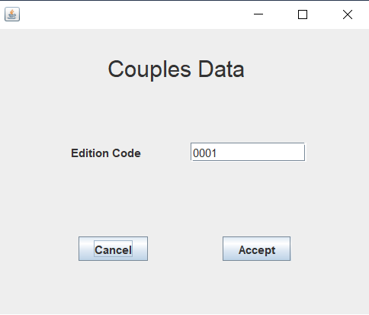
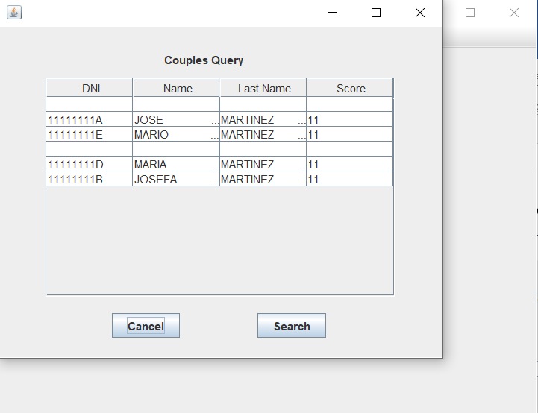
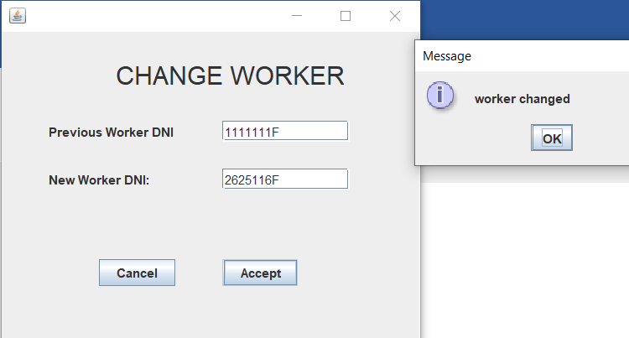
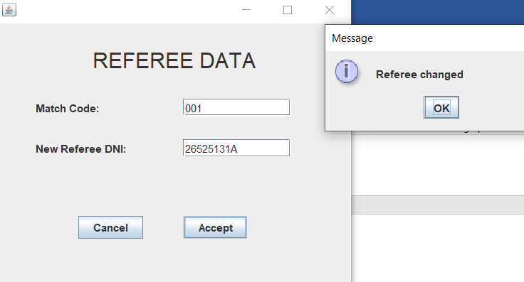
Other menus

Slide 6
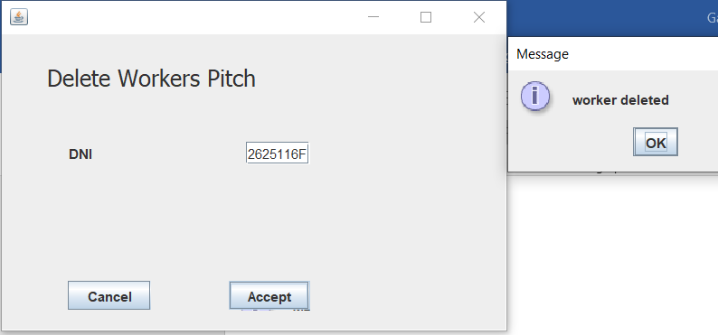
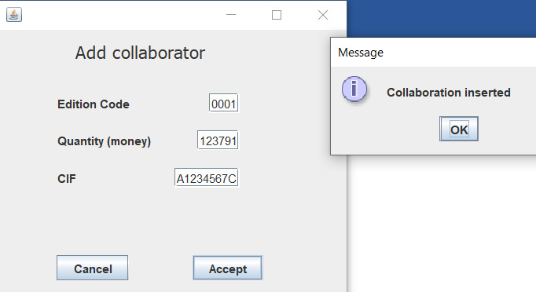
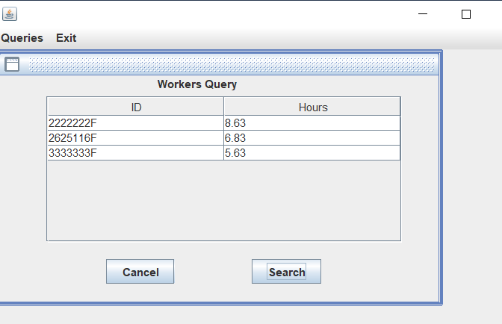
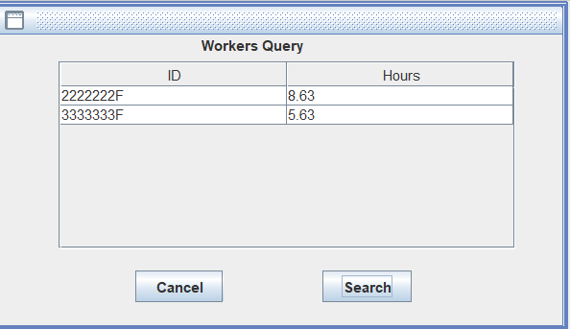
More other menus
-Insert material: with edition code and material information
-Delete material: with material code
-delete collaboratior: you can delete with cif and edition

